Slide 1
HR ANALYTICS PROJECT
Project Members
1.Sakshi Wagh
2.Sanket Ghadge
3.Komal Jangid
4.Manish Chavhan
5.Mounik
6.Giridrago

Slide 2
Problem Statement
Employee retention is a critical challenge for organizations aiming to maintain a stable and productive workforce.
High attrition rates can lead to increased hiring costs, loss of institutional knowledge, and decreased employee morale.
This project leverages HR analytics to identify key factors influencing employee retention by analyzing two datasets (HR_1 and HR_2), each containing 50,000 records.
Using Excel-based data analysis, this study will explore employee demographics, salary trends, promotion history, work-life balance, and job satisfaction levels to uncover patterns in employee turnover.
The goal is to provide data-driven insights that help HR teams design better policies for improving employee satisfaction, reducing attrition, and fostering long-term workforce stability.

Slide 3
Dataset Description
The HR_1 and HR_2 datasets contain structured Excel data with 50,000 records each, focused on HR analytics and employee retention.
These datasets likely include key HR metrics that help analyze factors influencing employee turnover, job satisfaction, and workforce stability.
Features in the Datasets
Employee Demographics: Age, Gender, Department, Job Role
Compensation Details: Salary, Bonus, Hourly Rate
Work Experience: Years at Company, Years in Current Role, Promotions
Work-Life Balance: Overtime, Job Satisfaction, Work Hours
Attrition Details: Resignation Reason, Time Since Last Promotion
Performance Metrics: Performance Rating, Training Hours

Slide 4
KPI’s And Insight
1. Average Attrition Rate for All Departments
Measures the percentage of employees leaving the organization across all departments.
Helps identify which departments have higher turnover and need better retention strategies
2. Average Hourly Rate of Male Research Scientists
Calculates the mean hourly wage for male employees in the Research Scientist role.
Useful for salary benchmarking and ensuring fair compensation policies.
3. Attrition Rate vs. Monthly Income Statistics
Analyzes the relationship between employee attrition and their monthly income.
Helps determine if salary dissatisfaction is a major reason for employee turnover.

Slide 5
4. Average Working Years for Each Department
Measures the average tenure of employees within each department.
Useful for understanding job stability and identifying departments with long-term employees.
5. Job Role vs. Work-Life Balance
Compares different job roles to their reported work-life balance ratings.
Helps HR understand how workload and stress vary across roles.
6. Attrition Rate vs. Years Since Last Promotion
Analyzes the impact of promotion frequency on employee attrition.
Helps identify if lack of career growth is a reason for high turnover.

Slide 6
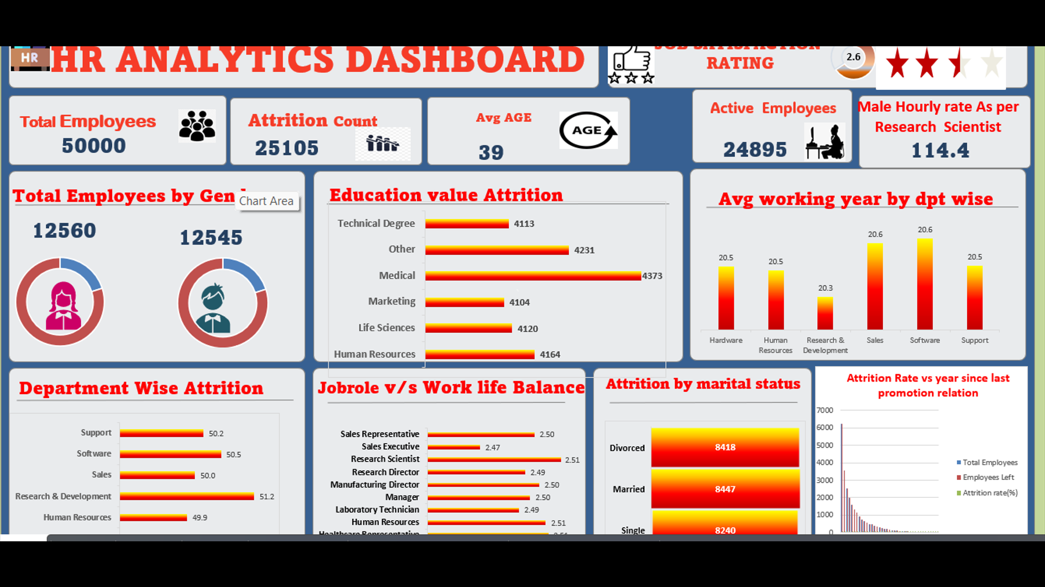
Excel Dashboard

Slide 7
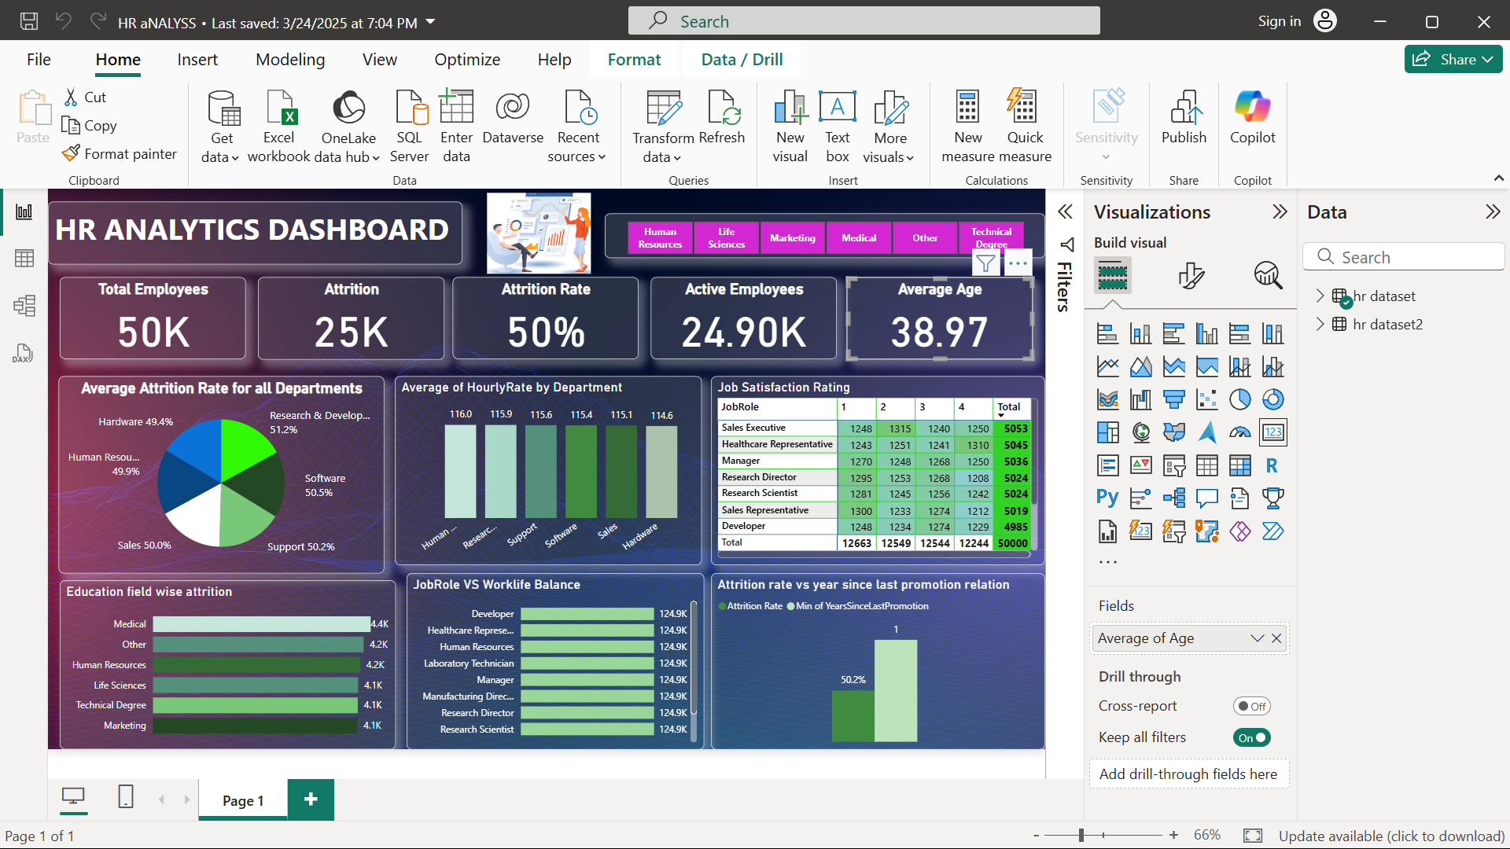
Power Bi Dashboard

Slide 8
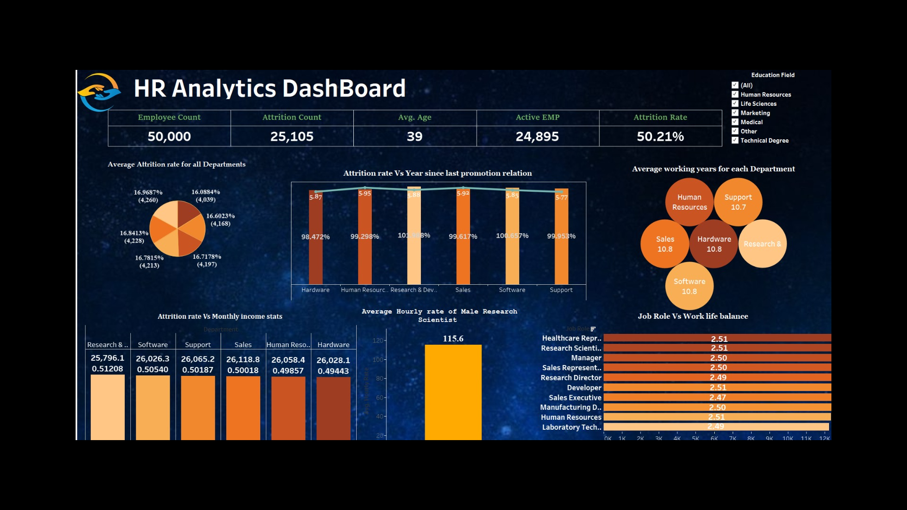
Tableau Dashboard

Slide 9
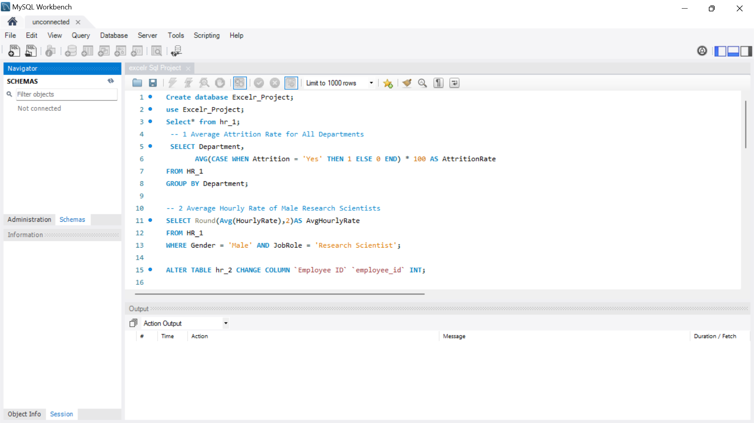
SQL Query 1 And 2

Slide 10
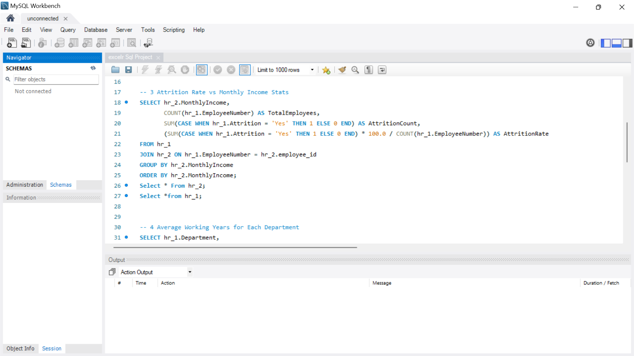
SQL Query 3

Slide 11
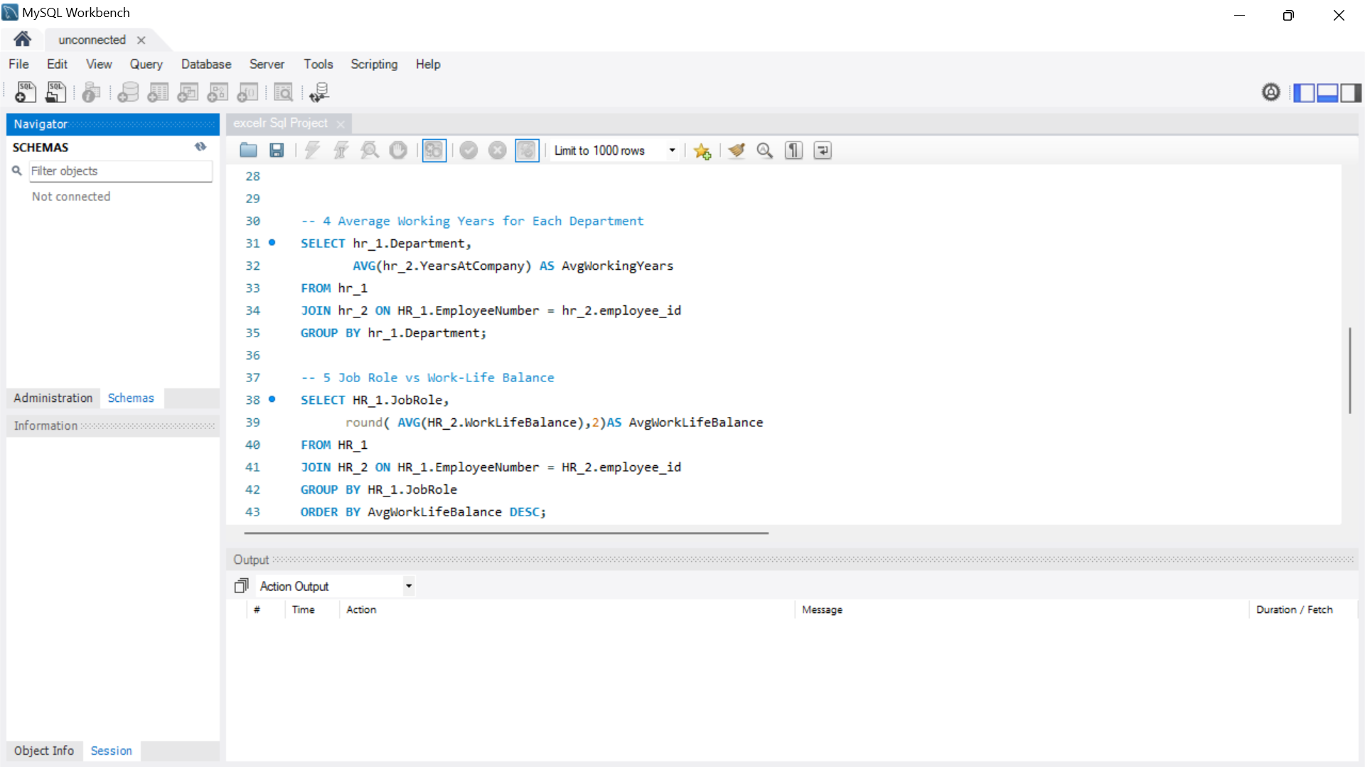
SQL Query 4 And 5

Slide 12
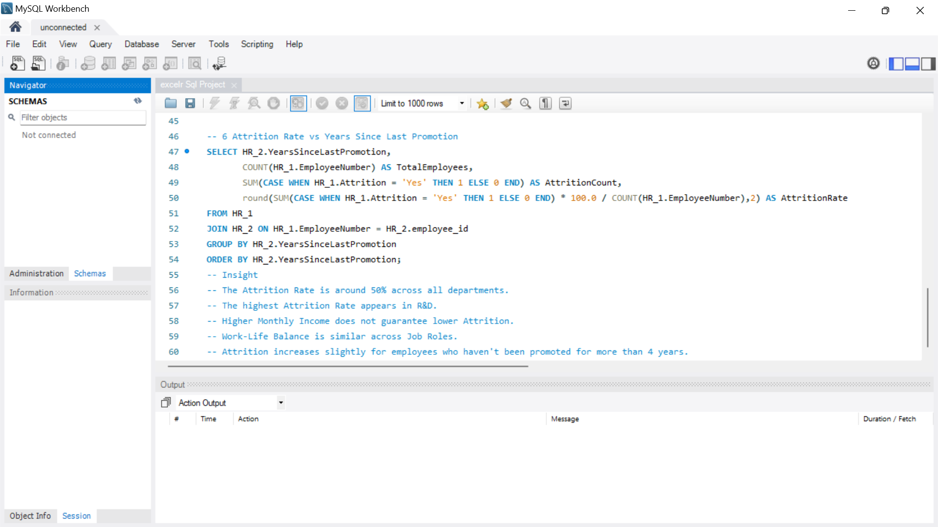
SQL Query 6

Slide 13
Conclusion
The HR Analytics Project provided key insights into employee attrition, work-life balance, and compensation trends.
By analyzing large datasets, we identified factors affecting retention and job satisfaction.
The findings help HR teams develop better policies, improve employee engagement, and optimize salary structures.
Understanding promotion trends and department-wise attrition enables data-driven decision-making.
Overall, the project helps organizations enhance workforce stability and efficiency.

Slide 14
Thank You

